Slide 1
Federated Learning for Image
Classification Across Different Modalities
Presented by Group CS54-2
Presenters: Rajiv, Eshan, Mohamad, David, Ngai Chun, HanWen

Slide 2
Information
Presenter: HTIA0294 - Hanwen
Name | Uni Key | Roles/Responsibilities
Rajiv Mehta | rmeh0608 | Project Manager, Data Research, Reporting Team
Ngai Chun Fu | ngfu0299 | Data Scientist - Phase 1
Eshan Arora | earo0293 | Data Scientist - Phase 2
David Cortes Sanchez | vcor0924 | Data Scientist - Phase 3
Mohamad Akmal bin Abu Bakar | mbin0316 | Data Research and EDA, Reporting Team
HanWen Tian(Simon) | htia0294 | Data Research and EDA, Reporting Team
Notes:
Rajiv –

Slide 3
Motivations and Objectives
Presenter: HTIA0294 - Hanwen
The growing need for data privacy, especially in sensitive domains like healthcare, has created significant challenges for traditional machine learning approaches.
Objectives
Develop a multi-modal federated learning framework
Demonstrate real-world applicability
Deliver actionable insights

Slide 4
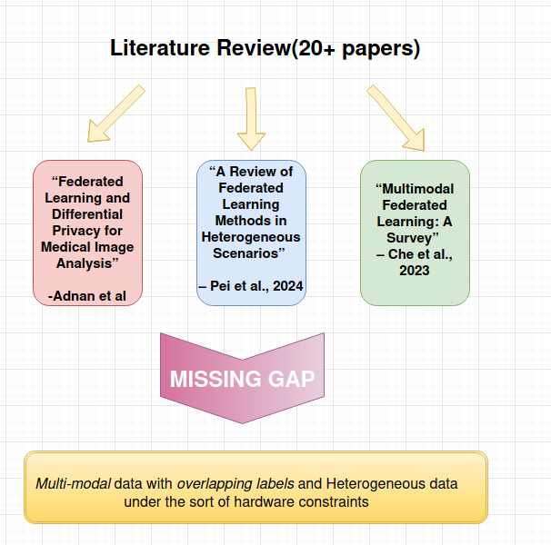
Related Work
Presenter: MBIN0316 – Akmal

Slide 5
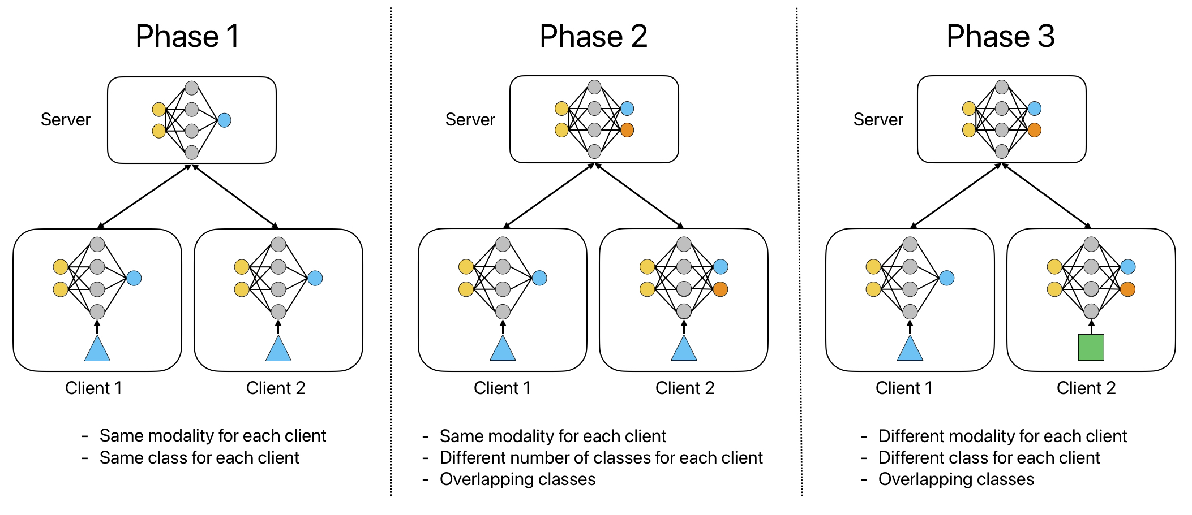
3 Development phases
Presenter: MBIN0316 – Akmal
Phase 1 - Singular Dataset, Singular Modality, Singular Class
Phase 2 - Single Datasets, Singular Modality, Multiple Classes
Phase 3 - Multiple Datasets, Multiple Modalities, Multiple Classes

Slide 6
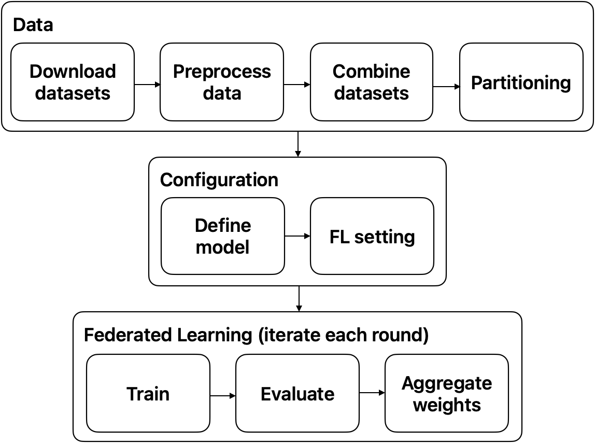
General Model Frameworks
Presenter: NGFU0299 – Ngai Chun

Slide 7
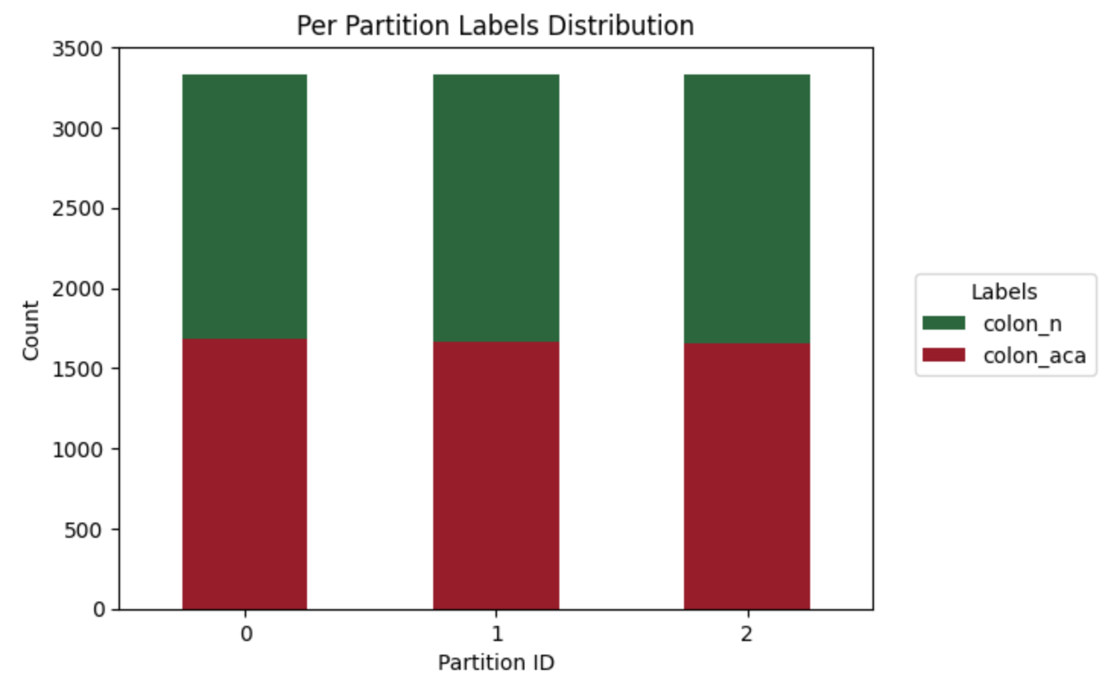
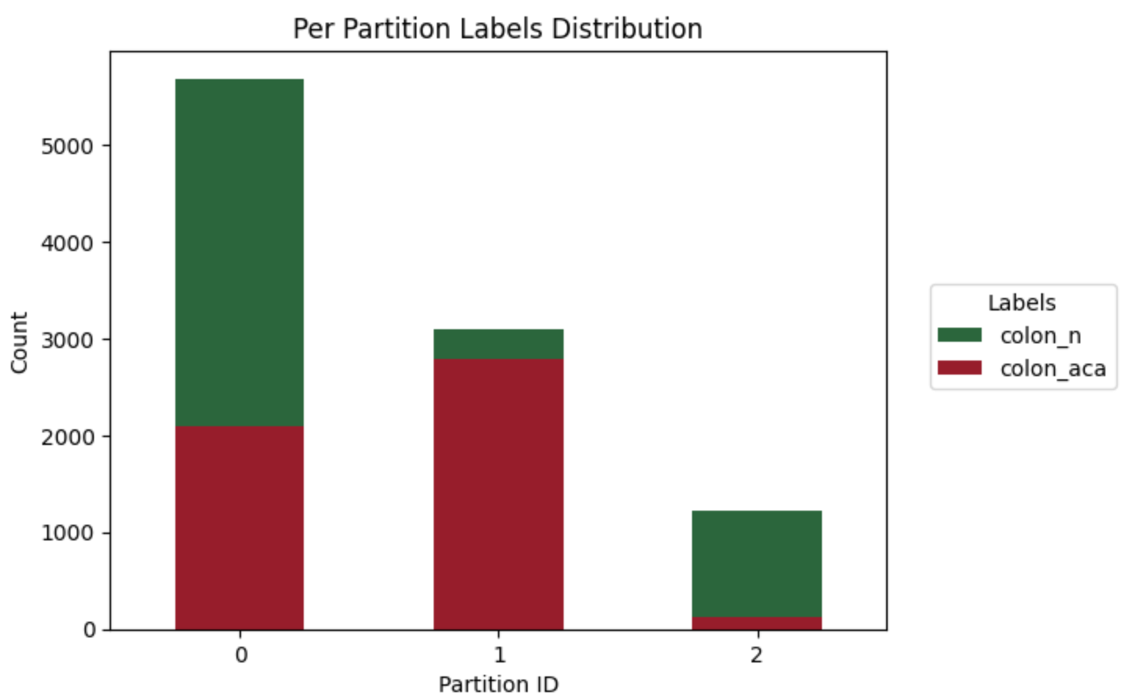
Phase 1
Presenter: NGFU0299 – Ngai Chun
IID partition:
Dataset: LC25000 (colon section)
whole slide images
Colon benign tissue (colon_n)
Colon adenocarcinoma (colon_aca)
Partition to 3 clients
Model:
CNN (80 rounds)
VGG11 (5 rounds)
Averaging method: FedAvg
Non-IID partition:
Notes:
Datasets and Brief Results

Slide 8
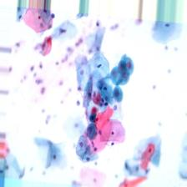
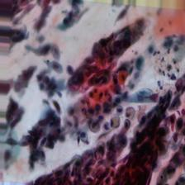
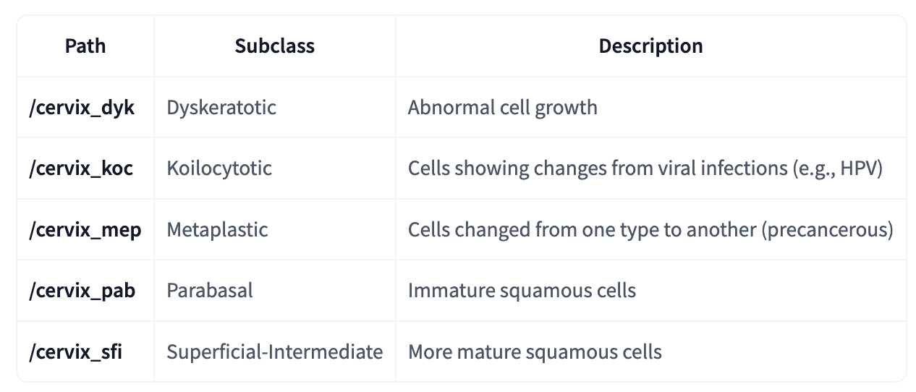
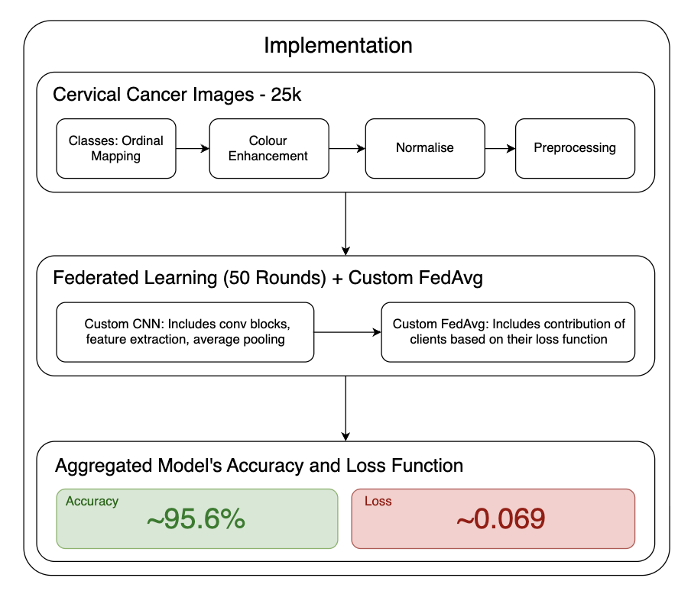
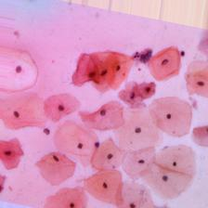
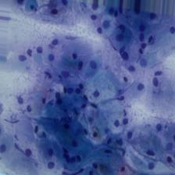
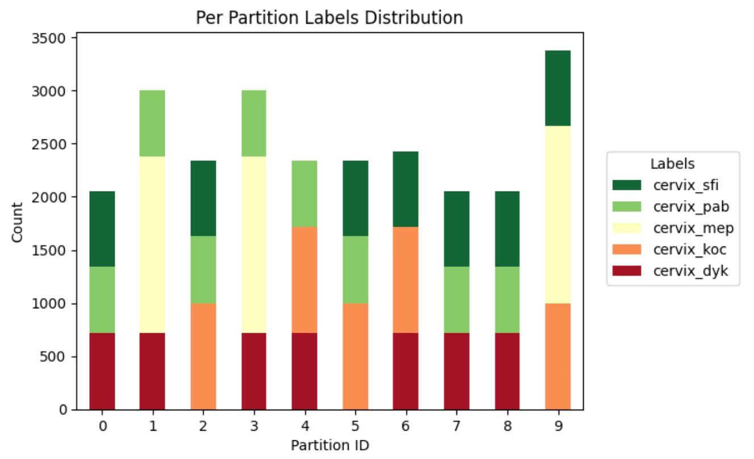
Phase 2
Presenter: EARO0293 – Eshan Arora
Cervical Cancer Dataset
EDA
Notes:
Datasets and Brief Results

Slide 9
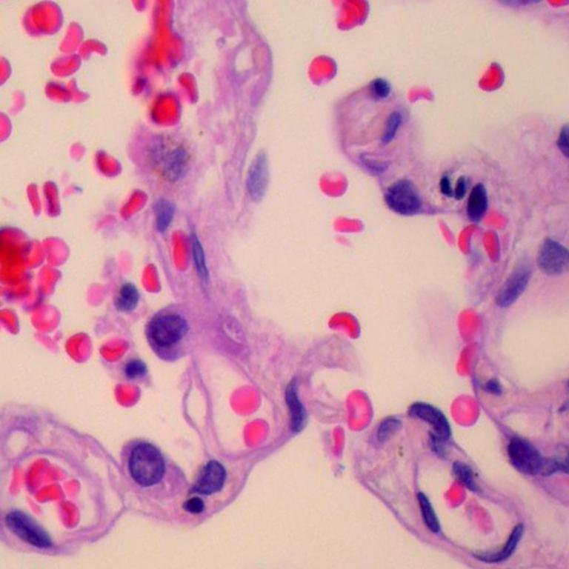
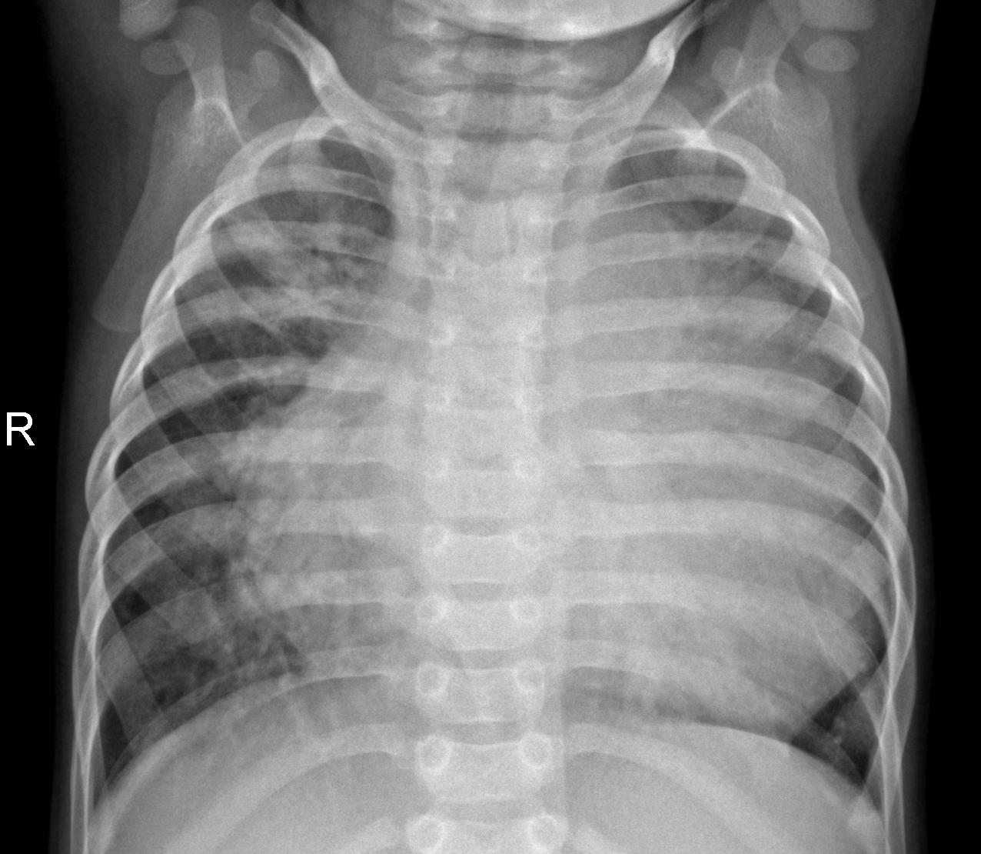
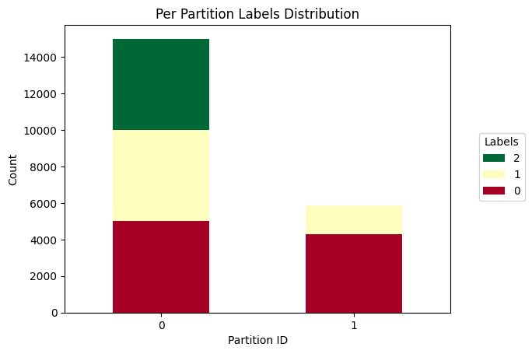
Phase 3
Presenter: VCOR0924 - David
Adenocarcinoma (5000)
Squamous cell carcinoma (5000)
Normal (5000)
Cancer (1583)
Normal (4273)
Head 1
Head 2
WSI
X-Ray
Shared
Fusion
Preprocess 1
Preprocess 2
Notes:
Datasets and Brief Results

Slide 10
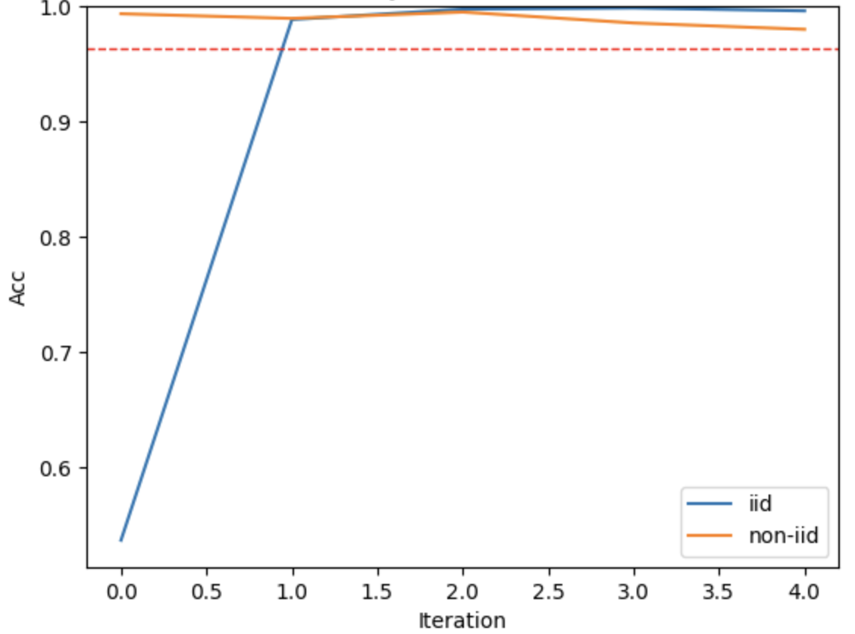
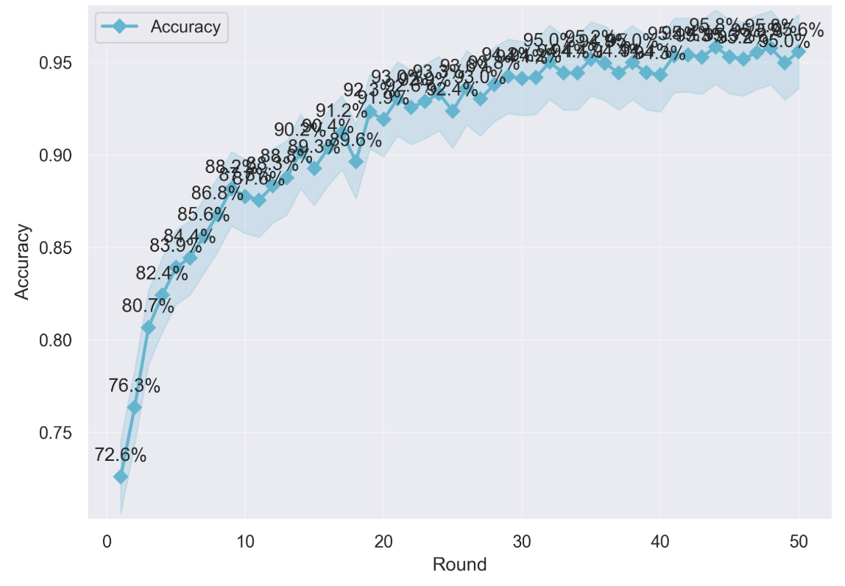
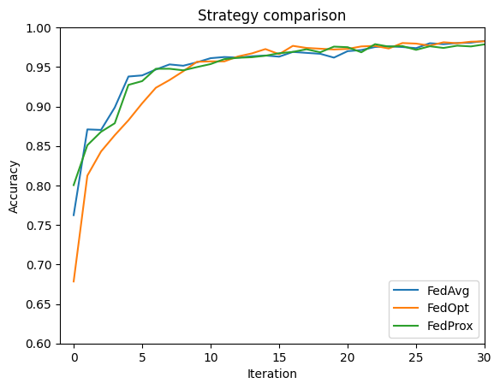
Results and Discussion
Presenter: VCOR0924 - David
Phase 1
Phase 2
Phase 3
Accuracy:
Accuracy:
Accuracy:
0.999 (IID)
0.995 (Non-IID)
0.956 (Custom FedAvg)
0.988 (FedOpt)

Slide 11
Results and Discussion
Presenter: VCOR0924 - David
Medical image datasets have a unique distribution.
Heterogeneity varies significantly between phases due to different modalities and class distributions.
There are differences between phases. We had to search for datasets that met the requirements, and the models depended on the type of problem (i.e., the dataset).
A wide range of strategies can be applied to each specific case, which affects convergence speed. This means we add to add a new parameter for optimization.

Slide 12
Conclusion, Reflection and Future Works
Presenter: RMEH0608 – Rajiv
Reflections
Time Management
Phase Planning and Scoping
Data Privacy and Modelling Techniques
Importance of Data Heterogeneity
Future Works
Various Machine Learning Model Implementations and Testing
Data Privacy Testing
Stress testing with more clients, modalities and larger datasets.
Optimisation of CustomFedAvg

Slide 13
Thank You!

